Slide 1
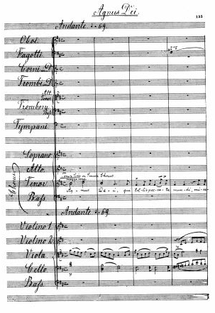
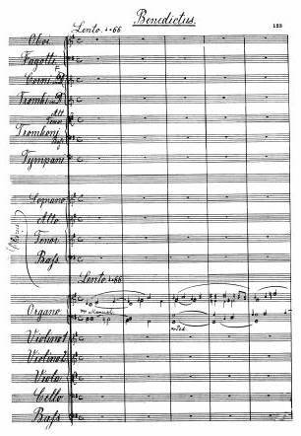
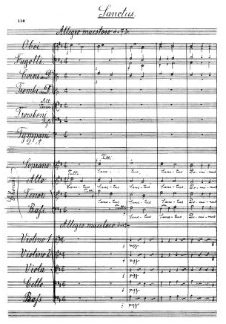
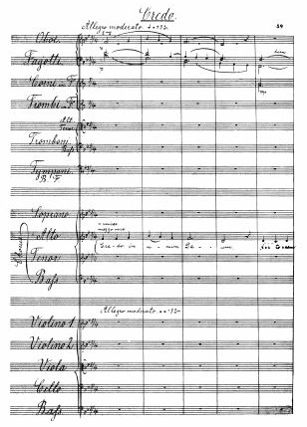
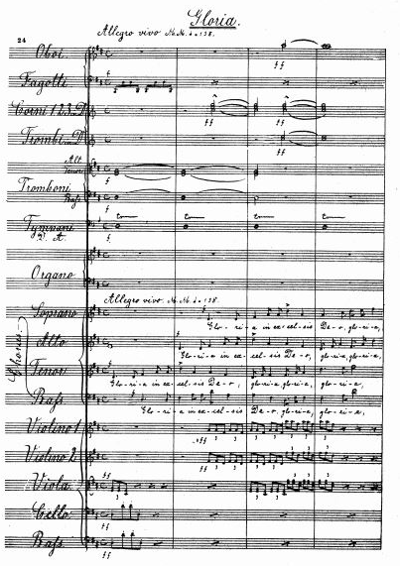
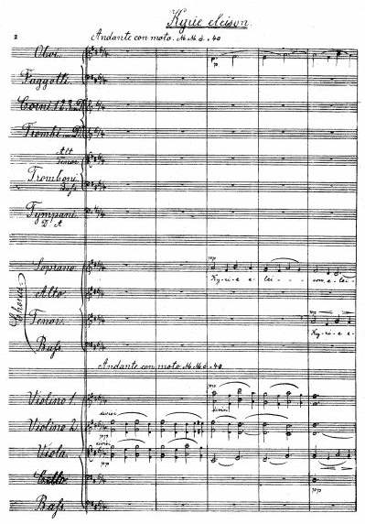
D
Civil Service
Choir
HOLY WEEK FESTIVAL
vořák
1.05pm Tuesday 7 April
St John’s Smith Square
London SW1P 3HA
Charity
collection
supporting
Ticketed (free admission)
via box office in person
or phone 020 7222 1061
www.sjss.org.uk
www.civilservicechoir.org.uk

Slide 2
Civil Service
Choir
HOLY WEEK FESTIVAL
Dvořák – Mass in D Major Op. 86
THE CIVIL SERVICE CHOIR & ORCHESTRA CONSORT
Stephen Hall OBE – CONDUCTOR
The outstanding Civil Service Choir is once again at SJSS for Holy Week, this year with Dvořák Mass in D major, Op. 86. Written in 1887, the Mass is meditative in character – perfect for Holy Week – with harmonic richness and folksong-like melodies.
The choir has delighted SJSS audiences every time and this concert has free ticketed admission. There will be a charity collection in the hall.
HOLY WEEK FESTIVAL
Palm Sunday 5 April – Easter Sunday 12 April
A week of evening concerts, lunchtime recitals, workshops, and late-night liturgical events, exploring a vast range of sacred music in celebration of Holy Week.
Patrons are warmly invited to our Footstool restaurant for food and drink before or after the concert.
Curated by Tenebrae in partnership with St John’s Smith Square.
St John’s Smith Square Charitable Trust, Registered Charity No. 1045390, Registered in England, Company No. 028678 www.sjss.org.uk

